Slide 1





Smart Click
Multi-Location Wireless Light Switch

Slide 2

Release Plan

Slide 3
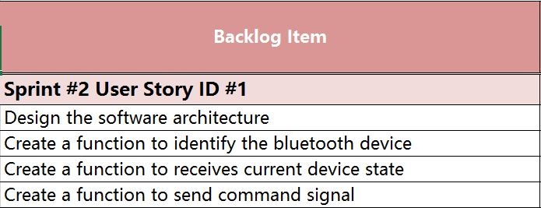
Sprint 2 Backlog
As an User I want my application to control the light switch

Slide 4
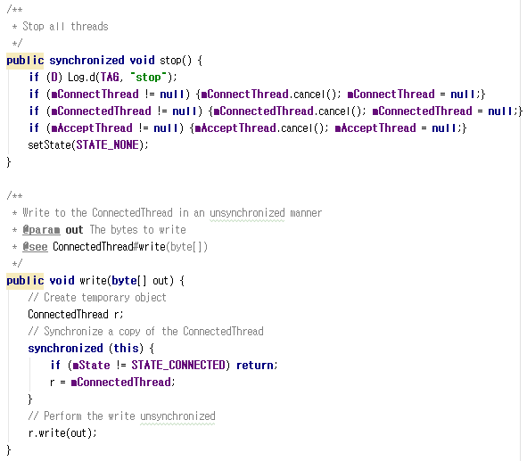
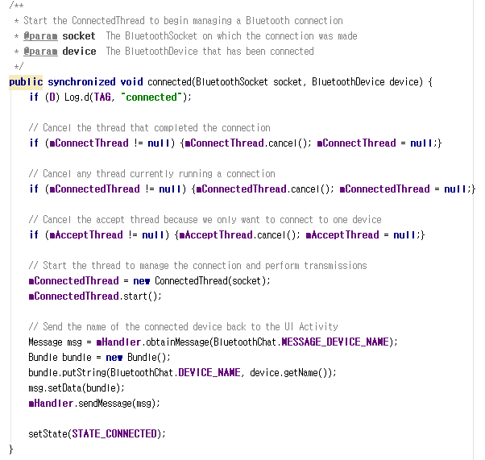
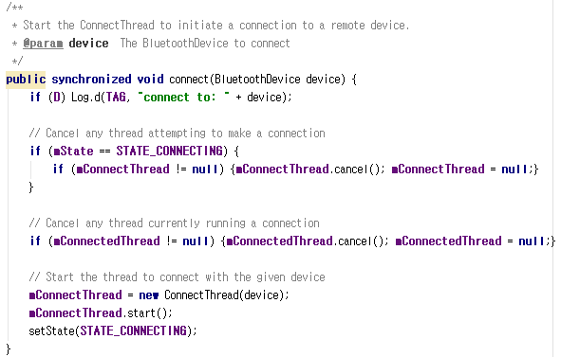
Create a function to identify the bluetooth device

Slide 5
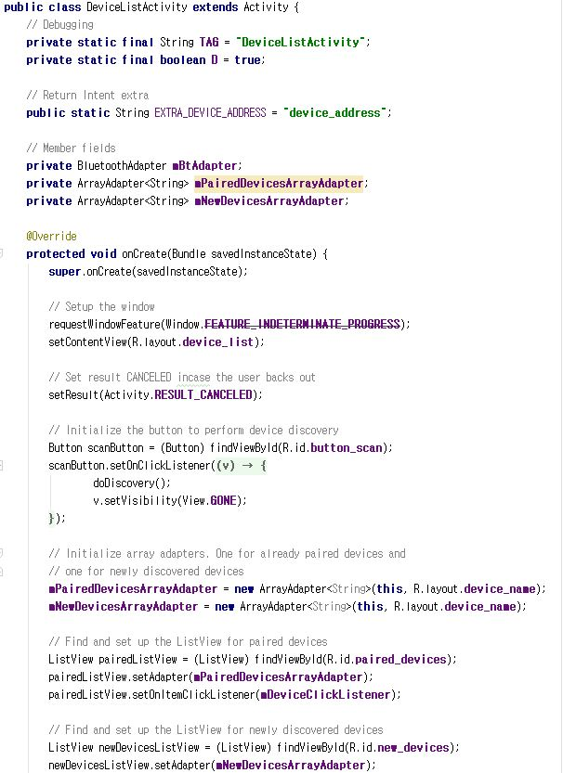
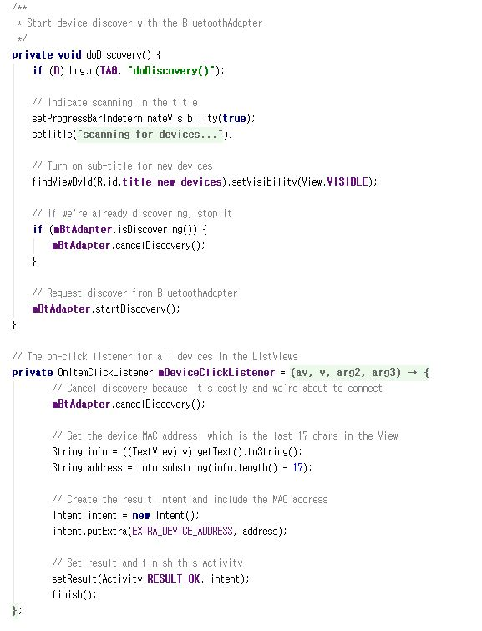
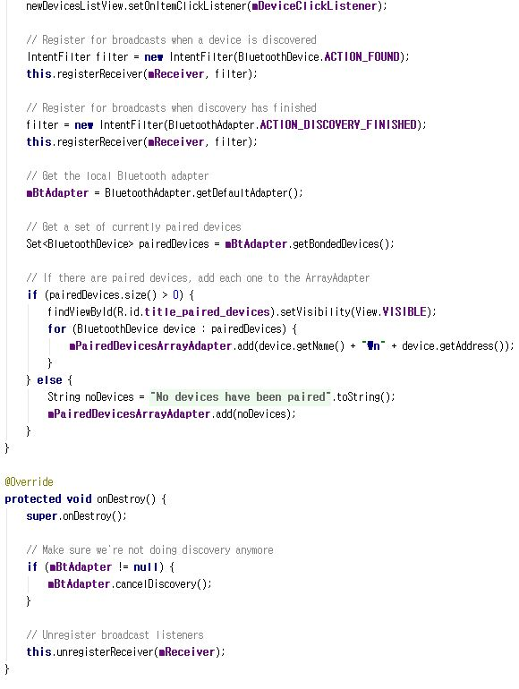
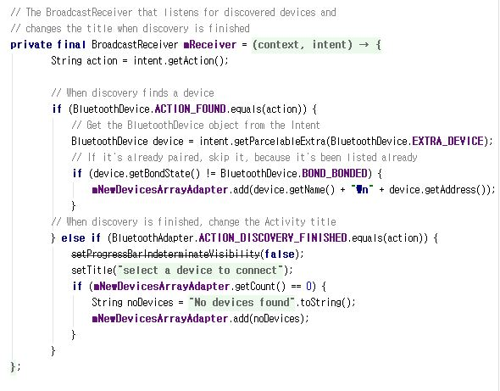
Create a function to receives current device state

Slide 6
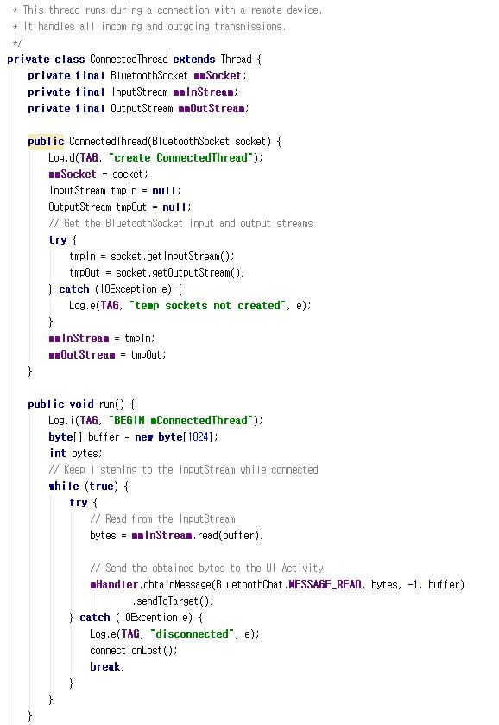
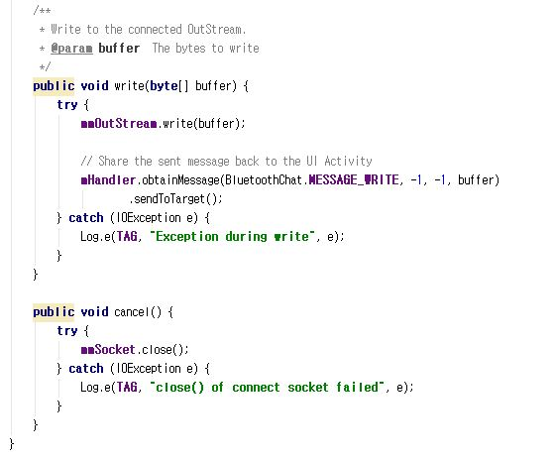
Create a function to send command signal

Slide 7

Sprint 3 Backlog
As an User I want my application to automatically connect to Bluetooh

Slide 8
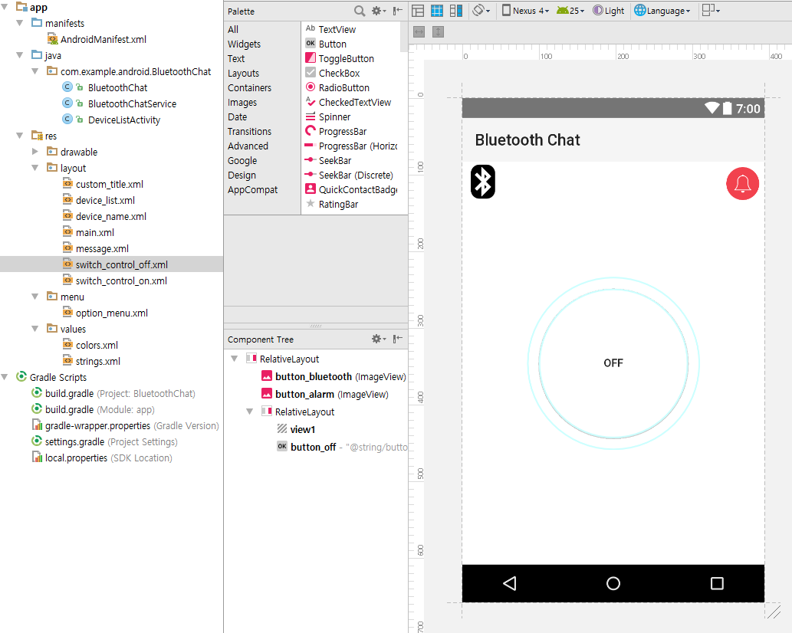
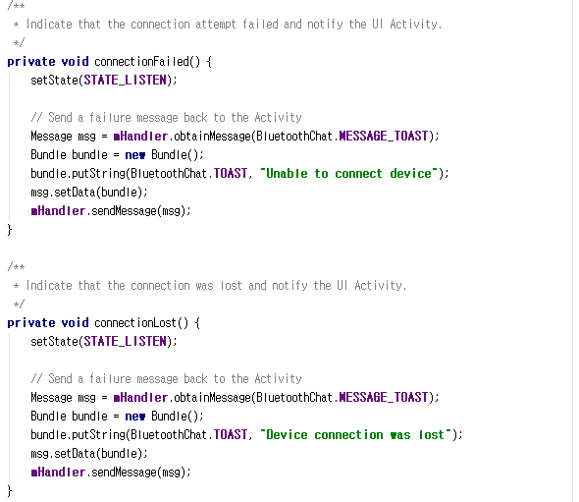
Indicate service when the application start
Notes:
This is configuration architecture.

Slide 9
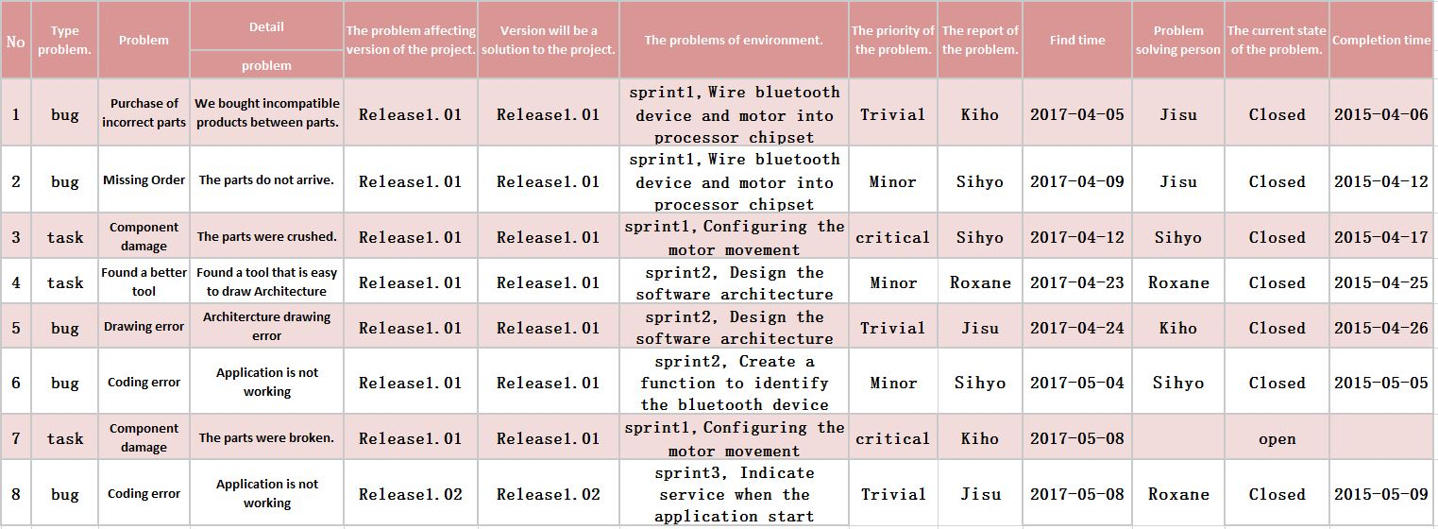
Defects Management

Slide 10


